Slide 1
Gynae Triage Senior Nurse Role of referrals to Women’s Clinic CCDHB.
Sally-ann grant RN, PG cert in Professional Nursing Practice.

Slide 2
Objective
To share my experience and development of the Gynae Triage Nurse Role.
What this role entails and how we see this role evolving in the future.
Barriers which have occurred on it’s development so far.

Slide 3
How it all Began.
Denise Braid Clinical Nurse Manager Women’s Clinic undertook triaging simpler referrals as part of her role. The SMO’s triaged the complex referrals, following the Health pathways.
Urology has had a nurse triage ( their CNS) for at least 5 years. Shelley was unsure how long she has been triaging, it’s been that long ☺.
A decision was made by the Senior Clinical & management team that a role be advertised for Registered Nurse in 2018 looking at becoming a Senior nurse in the future.
Along I came☺

Slide 4
Development
Initial Meeting with the clinic lead Dr Jackie Hawley to discuss development of Nurse triage.
Setting up a separate Gynae Nurse email inbox for the referrals to be triaged.
Gynae referrals inbox triaged by SMO on call could be several days before referrals triaged.

Slide 5
List of referrals to be sent to Gynae Nurse in box
Post menopausal bleeding (PMB)
Abnormal bleeding (AUB)
Intramenstral bleeding (IMB)
Menorrhagia (Heavy Menstrual bleeding)
Heavy periods
Endometrial polyps
Infertility ( a change in process).
A list with the referrals to be sent to Gynae Nurse inbox to the booking Clerk
Booking clerk to send any referral unsure of to Gynae Triage Nurse in box
Following the health pathways for triaging.
Using the Faster Cancer accept Button on email for PMB referrals.

Slide 6
Evolving the role
Spending time with the booking clerk .
Numerous changes in booking clerks 2018-2020
Questions from booking clerk coming to Gynae Triage Nurse not Charge Nurse manager of Women’s Clinic.
Triaging looked at Daily by Gynae Triage Nurse.
Weekly meeting with Dr Hawley to discuss issues, what's working , what's not working
Gynae Triage nurse orders/ looks up investigations GP not attached to referrals.

Slide 7
2019
Change in clinic Lead Dr Nick Bedford. Draft Guidelines introduced
SMO continued to triage when on call.
Later in the year Gynae Triage Nurse referral list increased
Fibroids
Trans Gender transitional surgery
Tubal Ligation (sterilisation)
Jadelle removal.

Slide 8
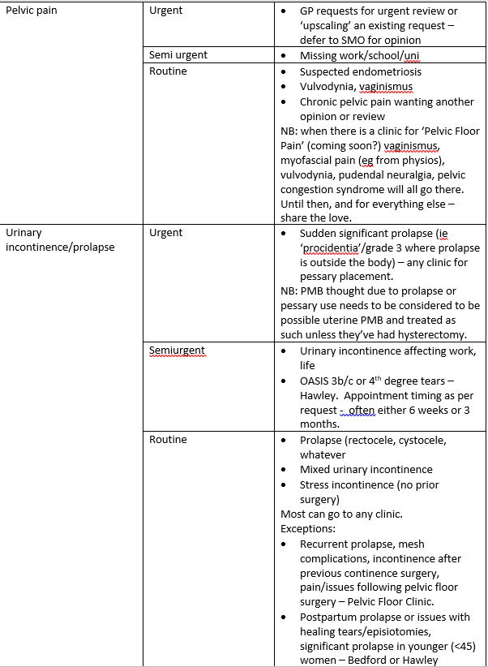

Slide 9
2020
Coro virus arrives. Triaging still done as before, slight reduction in referrals, smaller clinics.
Checking Gynae referrals inbox for urgent referrals
RN role evolved into Gynae Triage Senior nurse .3 FTE RN .7 FTE .
October 2020 relook at guidelines.

Slide 10
2021
3 SMO’s now responsible for Triaging
Dr Jackie Hawley
Dr Nick Bedford
Dr Leigh Searle
November 2021 Guidelines re looked at and awaiting to be finalised

Slide 11
2022
Omnicom arrives, clinics reduced triaging continues. SMO writing to GP to decline referral with advise.
Gynae Triage Senior Nurse Role established full time.

Slide 12
Evaluation of the role
Gynae triage nurse role has developed and evolved over the last 3 years.
Referrals triaged in a timely manner
Good support from Senior Clinical & Management Team
Less time spent by clinic nurses trying to find investigations, rescheduling patients as investigations not been done.
Still working on Guidelines so majority of referrals can be triaged by Gynae Triage Nurse.

Slide 13
Acknowledgments
Denise Braid Nurse Manager Women’s Clinic & Te Mahoe
Dr Jackie Hawley
Dr Nick Bedford
Dr Leigh Searle
Natalie Rankin Booking Clerk Gynaecology
Miranda Wiltshier Senior Outpatient Administrator.

Slide 14
THANK-YOU

